Slide 1

SUBPART A: ACRONYMS AND DEFINITIONS. SECTIONS 200.0-200.1
SUBPART B: GENERAL PROVISIONS. SECTIONS 200.100-200.113
SUBPART C: PRE FEDERAL AWARD REQUIREMENTS. SECTIONS 200.217-200.200
SUBPART D: POST FEDERAL AWARDS REQUIREMENTS. SECTIONS 200.300-200.346
SUBPART E: COST RPINCIPLES. SECTIONS 200.400-200.476
SUBPART F: AUDIT REQUIREMENTS. SECTIONS 200.500-200.521

Slide 2

SUBPART A. ACRONYMS AND DEFINITIONS. SECTIONS 200.0-200.1

Slide 3

Language changes
“Cost sharing or matching” is now only “cost sharing”
“Federal awarding agency” is now only “Federal agency”
“For-profit organization” is now included within “private entity”
“Non-Federal Entity” is now referred to as “recipient” and/or “subrecipient”

Slide 4
Revised Definitions and Acronyms
Revised Definitions:
Questioned costs
Indian Tribe
Indirect (F&A) Cost
Participant
Supplies
Acronyms
Removal of “FAPIIS”
Removal of “FAIN”
Addition of “NOFO”
Removal of "PTE“

Slide 5
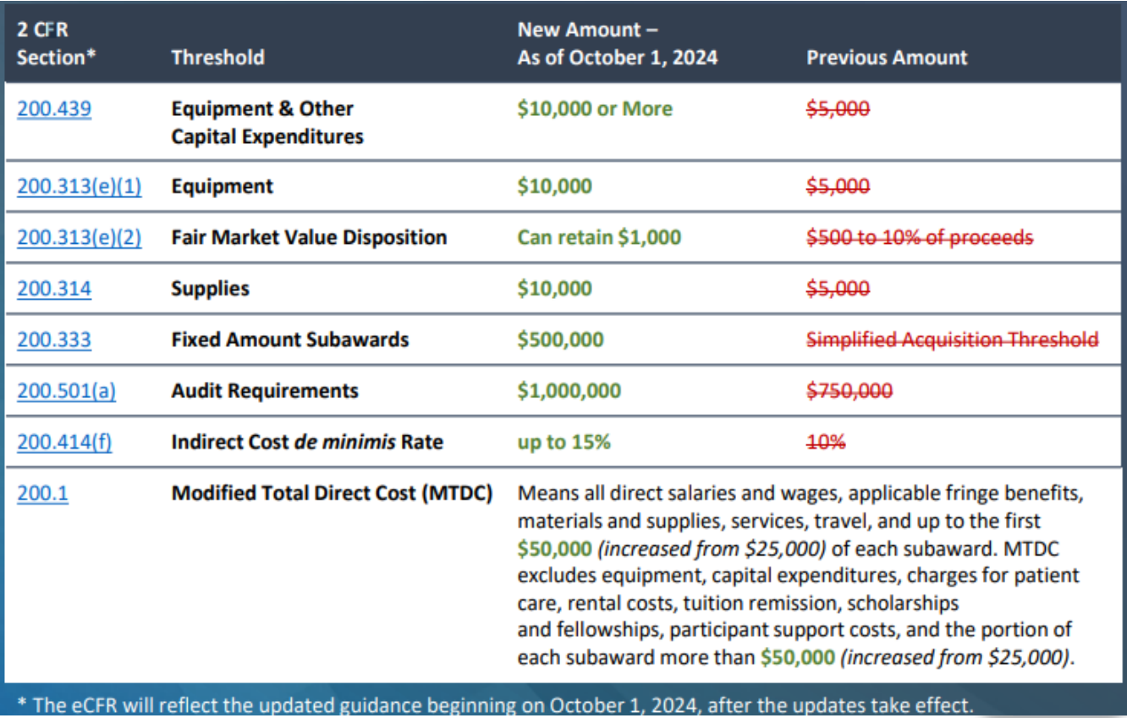

Slide 6
SUBPART B. GENERAL PROVISIONS. SECTIONS 200.100-200.113

Slide 7



Mandatory Disclosures. Section 200.113
An applicant, recipient, or subrecipient of a Federal award must promptly discolse whenever, in connection with the Federal award (including any activities or subawards thereunder), it has credible evidence of the commission of a violation of Federal criminal law involving graud, conflicto of interest, bribery, or gratuity violations.
The disclosure must be made in writing and to the Federal agency, the agency’s Office of Inspector General, and pass through entity (if aplicable)
Recipients and subrecipients are also required to report matters related to tecipient integrity and performance

Slide 8
SUBPART C. PRE FEDERAL AWARD REQUIREMENTS. SECTIONS 200.217-200.200

Slide 9

Fixed Amount Awards and Subawards. Section 200.201
Program Income (PI) rules are not applicable to fixed amount awards: “A fixed amount award may generate and use program income in accordance with the terms and conditions of the Federal award; however, the requirements of § 200.307 do not apply”.
When the required activities were not carried out, including fixed amount awards paid on a unit price basis under 200.201(b)(1)(ii), the amount of the Federal award must be reduced by the amount that reflects the activities that were not completed in accordance with the Federal award.
When the required activities were completed in accordance with the terms and conditions of the Federal award, the recipient or subrecipient is entitled to any unexpended funds
Requires, upon conclusion of a fixed amount award, the identification of activities that were not completed.
Accountability now must be based on performance and results which can be communicated in performance reports or through routine monitoring.
No financial reporting is required, BUT the recipient/subrecipient must still meet record retention requirements nor are they absolved from the responsibilities of making records available for review during an audit.

Slide 10
Notices of Funding Opportunities. Section 200.204
The Federal agency must announce specific funding opportunities for Federal financial assistance that will be openly competed.
The Federal agency must maintain an accurate list of Federal programs in the Assistance Listings maintained by the General Services Administration (GSA) at SAM.gov.
The Federal agency should communicate opportunities to the public in plain language, it also may translate formal or informal announcements of the availability of Federal funding when translations may serve to increase the participation of a specific community.
The Federal agency should only include the information that is necessary for the effective communication of the program objectives.
Federal agencies may offer pre-application technical assistance or provide clarifying information for funding opportunities.
Federal agencies must ensure these resources are made accessible and widely available to all potential applicants (for example, by posting answers to questions and requests on Grants.gov)

Slide 11
Notices of Funding Opportunities. Section 200.204
The new following information must be provided in the notice of funding opportunities in a public notice:
  Funding Details: The total amount of funding that the Federal agency expects to award, the anticipated number of awards, and the expected dollar values of individual awards, which may be a range or average;
  The Federal agency should provide an anticipated award date.
  Executive Summary. A brief description that is written in plain language and summarizes the goals and objectives of the program, the target audience, and eligible applicants. The text of the executive summary should not exceed 500 words;
  Agency contact information.

Slide 12
Whistleblower Protections. Section 200.217
Recipients and subrecipients must now inform employees in writing of whistleblower rights and protections.

Slide 13
SUBPART D. POST FEDERAL AWARDS REQUIREMENTS. SECTIONS 200.300-200.346

Slide 14


Performance Measurement. Section 200.301
The Federal agency will establish program goals and objectives during the program plan design, which will clearly communicate the specific program goals and objectives in the Federal award, including:
• How the Federal Agency will measure the achievement of the goals and objectives.
• The expected timeline.
• Information on how the recipient must report the achievement of program goal and objectives.
• Any expected outcomes such as outputs, service performance, or public impacts.
• Indicators, targets, baseline data, or data collections that the recipient is responsible for measuring and reporting.

Slide 15
Internal Controls. Section 200.303
A recipient/subrecipient must:
Establish, document and maintain effective internal control over the Federal award.
This internal controls should align with the guidance in “Standards for Internal Control in the Federal Government”
Take prompt action when instances of noncompliance are identified
Add cybersecurity internal controls. OMB will consider providing more specific guidance on this topic in the future but in the interim, will leave it to the Federal agencies to consider providing more specific guidance on the topic, as appropriate.

Slide 16
Federal Payments. Section 200.305
• Advance payment mechanisms must now comply with 31 CFR part 208 and include, but are not limited to treasury checks and electronic funds
• Recipients/subrecipients must be authorized to submit payment requests as often as necessary when electronic fund transfers are used or at least monthly when electronic transfers are not used.
• Recipient/subrecipient must maintain advance payments of Federal funds in interest-bearing accounts, unless an interest-bearing account is not readily accessible.
• All interest more than $500 per year must be returned to Payment Management System (PMS) regardless of whether the recipient or subrecipient was paid through PMS. Instructions for returning interest can be found at https://pms.psc.gov/grant-recipients/returning-funds-interest.html.

Slide 17
Cost Sharing. Section 200.306
Voluntary committed cost sharing is not expected under Federal research grants.
Voluntary committed cost sharing may not be used as a factor during merit review for Federal research grants or proposals for Federal research grants unless authorized by Federal statues or agency regulations and specified in the notice of funding opportunity.
Federal agencies are also discouraged from using voluntary committed cost sharing as a factor during the merit review of applications for other Federal financial assistance programs.
For all Federal awards, the Federal agency or pass-through entity must accept any cost sharing funds including funds committed by the recipient, subrecipient, or third party as part of the recipient’s or subrecipient’s contributions to a program with specific funds outlined within the part.
Institutions of Higher Learning (IHE), voluntary uncommitted cost sharing should be treated differently from mandatory or voluntary committed cost sharing.

Slide 18
Program Income. Section 200.307
The recipient/subrecipient is now encouraged to earn income to defray program costs when appropriate and must be used for the original purpose of the Federal award.
Program income earned during the period of performance may only be used for costs incurred during the period of performance or allowable closeout costs. See § 200.472(b).
Program income must be expended prior to requesting additional Federal funds.
The Federal Agency may now negotiate agreements with recipients regarding appropriate uses of income earned after the end of the period of performance as part of the closeout process.
Governmental revenues, Property and License fees and royalties are not considered program income unless specified in Federal statutes, regulations, or the terms and conditions of the Federal award.

Slide 19
Use of Program Income. Section 200.307
Deduction, addition, and cost sharing:
The Federal agency should specify what program income method(s) will be used
The deduction method will be used if the Federal agency does not specify a method for applying program income.
When no program income method is specified in the Federal award, prior approval is required to use the addition or cost sharing methods.
However, the addition method will be used when no method is specified for awards made to institutions of higher education (IHE) and nonprofit research institutions.
In specifying alternatives to the deduction and addition methods, the Federal agency may distinguish between income earned by the recipient and income earned by subrecipients as well as between the sources, kinds, or amounts of income.
Program income exceeding amounts specified in the Federal award may be added to or deducted from the total allowable costs in accordance with the terms and conditions of the Federal award.

Slide 20
Revision of Budget and Program Plans. Section 200.308
Recipient or subrecipient must report deviations from the approved budget, project or program scope, or objective in accordance with 200.329.
When requesting approval for budget revisions, the recipient must use the same format for budget information that was used in their application except if the Federal agency has approved an alternative format (may include the use of electronic systems, email, or other agency-approved mechanisms).
The Federal agency or pass-through entity must review the request for budget or program plan revision and should notify the recipient or subrecipient whether the revisions have been approved within 30 days of receipt of the request.
The Federal agency or pass-through entity must inform the recipient or subrecipient in writing when a decision can be expected if more than 30 days is required for a review.

Slide 21
Revision of Budget and Program Plans. Section 200.308
Limitation on other prior approval requirements. Unless specified in this guidance, the Federal agency must not impose additional prior approval requirements without OMB approval
Recipients must request prior written approval from the Federal agency or pass-through entity if there is a change in key personnel, changes in total approval cost-sharing amount, transferring funds between the construction and nonconstruction work under a Federal award, a no-cost extension (with specific caveats).
A change of subrecipient only requires prior approval if the Federal agency or pass-through entity includes the requirement in the terms and conditions of the Federal award or unless the inclusion was a determining factor in the merit review or eligibility process. This requirement does not apply to procurement transactions for goods and services.

Slide 22
Equipment. Section 200.313
The Equipment still requires prior approval.
Increases the acquisition value threshold relevant to the equipment definition from $5,000 to $10,000. So items costing $9,999 or less can be treated as supplies and material and included in the MTDC.
While the equipment is being used for the original purpose, the recipient or subrecipient must not dispose or encumber its title or other interests without the approval of the Federal agency or pass-through.
States and Indian Tribes must use, manage, and dispose of equipment in accordance with their procedures, if they do not exist, must follow laws and procedures of this section.
Physical inventories must now be conducted, and results reconciled with property records at least once every two years.
Control systems must now be in place to prevent property loss, damage, or theft, and must notify the Federal agency when there is an impact on equipment.
Reinforced the responsibility of recipients to maintain updated records regarding equipment

Slide 23
Equipment. Section 200.313
When included in the terms and condition of a Federal award, the Federal agency may permit the recipient to retain equipment or authorize a pass-through entity to permit the subrecipient to retain equipment, with no further obligation to the Federal Government unless prohibited by Federal statute or regulation.
Except as provided in § 200.312(b), or if the Federal agency or pass-through entity fails to provide requested disposition instructions within 120 days, items of equipment with a current fair market value in excess of $10,000 (per-unit) may be retained or sold by the recipient or subrecipient.
The Federal agency is entitled to an amount calculated by multiplying the percentage of the Federal agency’s contribution towards the original purchase by the current market value or proceeds from the sale.
If equipment is sold, the recipient/subrecipient may be able to retain $1,000 from the Federal Share to cover expenses associated with the selling and handling of the equipment.

Slide 24
Supplies. Section 200.314
When working to closeout the Federal award, unused supplies now need to be considered, which include all supply types.
Increased threshold from $5,000 to $10,000 regarding the requirement in 200.314(a) to remit unused supplies
Included a definition of “unused supplies” as supplies that are in new condition, not having been used or opened before
Clarified that the requirements for unused supplies apply to the aggregate value of all supply types, and not just like-item supplies
The awarding agency or pass-through is now entitled to compensation from unused supplies in an amount calculated by multiplying the percentage of the Federal agency’s or pass-through entity’s contribution towards the cost of the original purchase(s) by the current market value or proceeds from the sale.
If unused supplies are sold, the recipient/subrecipient may be able to retain $1,000 of the proceeds to cover expenses associated with the selling and handling of the supplies, if the awarding agency or passthrough approves it.

Slide 25
Procurement by States and Indian Tribes. Section 200.317
In recognition of Tribal sovereignty, revision to permit Indian Tribes to be treated the same as States, thereby allowing them to follow their own procurement policies and procedures as opposed to those in section 200.318 – 200.327, with noted exceptions related to a requirement to comply with 200.321, 200.322, 200.323 and 200.327, as applicable.
States or Indian Tribes must follow the same policies and procedures they use for procurements with non-Federal funds.
If such policies do not exist, States and Indian Tribes along with their subrecipients must follow the procurement standards outlined within 200.318 through 200.327.
In addition to its own policies and procedures, States and Indian Tribes must also comply with these sections:
  200.321 – Contracting with Small Businesses, Minority Businesses, Women’s Business Enterprises, Veteran-Owned Businesses, and Labor Surplus Area Firms
  200.322 – Domestic Preferences for Procurements
  200.323 – Procurement of Recovered Materials
  200.327/Appendix II – Contract Provisions

Slide 26
Competition. Section 200.319
Removed the prohibition on geographic preferences
New contractor preferences

Slide 27
Procurement Methods. Section 200.320
There are three types of procurement methods described in this section:
  Informal procurement methods (for micro-purchases and simplified acquisitions)
  Formal procurement methods (through sealed bids or proposals)
  Noncompetitive procurement methods.
For any of these methods, the recipient or subrecipient must maintain and use documented procurement procedures, consistent with the standards of this section and §§ 200.317, 200.318, and 200.319
Informal procurement methods may be used when the value of the procurement transaction under the Federal award does not exceed the micro-purchase threshold.
  This amount is either $10k (micro-purchase threshold in the FAR) or higher based on the recipient of subrecipient’s threshold which must be approved by the recipient or subrecipient’s cognizant agency (usually up to $50k). Recipient/subrecipient must maintain documents to support micro-purchase awards without soliciting competition.
Purchase cards may be used as a method of payment for micro-purchases

Slide 28
Procurement Methods. Section 200.320
Formal procurement methods are required when the value of the procurement transaction under a Federal award exceeds the simplified acquisition threshold of the recipient or subrecipient.
  Sealed bids. This is a procurement method in which bids are publicly solicited through an invitation with specific information, including any required specifications
  Tribal entities are no longer required to open sealed bids publicly.
  Includes slight revisions to include “the recipient or subrecipient may exercise judgment in determining what number is adequate” when referring to the number of rate quotations to be obtained.

Slide 29
Procurement of recovered materials. 200.323
Added a new section on the use of reused, refurbished, or recycled materials:
Recipient/subrecipients should prioritize products and services that can be reused, refurbished, or recycled; contain recycled content, are biobased, or are energy and water efficient; and are sustainable
This may include purchasing compostable items and other products and services that reduce the use of singleused plastic products.

Slide 30
Federal Agency or Pass-Through Entity Review. Section 200.325
Recipients/pass-through entities must now submit technical specifications of proposed procurements when requested by the awarding agency.
Reviews of technical specifications should now take place before technical specifications are incorporated into a solution document.
If a review is requested from recipient or subrecipient after a solicitation, the agency or pass-through entity may review for technical aspects.

Slide 31
Financial Reporting. Section 200.328
The recipient or subrecipient must submit financial reports as required by the Federal award.
Reports submitted annually must be due no later than 90 calendar days after the conclusion of the reporting period.
Reports submitted quarterly or semiannual must due no later than 30 calendar days after reporting period.
The final financial report must be due no later than 120 calendar days after conclusion of the period of performance.
A subrecipient must submit a final financial report to a passthrough entity no later than 90 calendar days after the conclusion of the period of performance; relates to Closeout at 200.344

Slide 32
Monitoring and Reporting. Section 200.329
New clause on responsibilities of recipients/subrecipients focused on reporting schedules and providing cost information.
The recipient/subrecipient are now responsible for the oversight of the Federal award and must monitor their activities to ensure compliance with all requirements and meeting performance expectations.
Must cover each program, function, or activity; as related to 200.332, Requirements for Pass-Through Entity.
Neither the Federal agency or pass-through entity can request reports more frequently than quarterly unless under specific conditions.
Performance reports must relate to financial data and project or program accomplishments in relation to the performance goals and objectives of the federal award.
Federal agencies should not solicit information from recipient or subrecipient that is not necessary for effective monitoring or evaluation of the award.
When significant developments impact reporting, the recipient/subrecipient must notify the awarding agency or passthrough entity.
If significant developments negatively impact the award, the recipient and subrecipient must now provide information within their plan for corrective action and include any assistance needed.

Slide 33
Subrecipient and Contractor Determinations. Section 200.331
The pass-through entity is responsable for making case-by-case determinations to determine whether the entity receiving Federal funds is a subrecipient or a contractor.
The Federal agency does not have a direct legal relationship with subrecipients or contractors of any tier; however, the Federal agency is responsible for monitoring the pass-through entity’s oversight of first-tier subrecipients.
Clarification was added to clarify that no single factor or combination of factors contained in this section is necessarily determinative.
Emphasis was noted on the need for the pass-through entity to exercise judgment in classifying each agreement as a subaward or a procurement contract. In making this determination, the substance of the relationship is more important than the form of the agreement.

Slide 34
Requirements for Pass-Through Entities. Section 200.332
Greater monitoring is expected on the oversight relating to “significant developments” negatively affecting the subaward which include:
  Single audit findings, other audit findings, site visits, and written notifications from a subrecipient of adverse conditions which impact their ability to perform the subaward.
  The subrecipient must now provide the pass-through with a plan for corrective action and assistance needed to resolve the situation.
  Addition of monitoring tools for pass-through entities.

Slide 35
Fixed Amount Subawards. Section 200.333
The amount of fixed amount subawards that a recipient may provide with prior written approval from the federal agency was increased from $250,000 (Simplified Acquisition Threshold) to $500,000.
Fixed amount subawards must still follow the requirements whithin 200.201(b)(1).
With prior written approval from the Federal agency, the recipient may provide subawards based on fixed amounts up to $500,000.

Slide 36
Termination. Section 200.340
When the Federal agency terminates the Federal award prior to the end of the period of performance due to the recipient’s material failure to comply with the terms and conditions of the Federal award, the Federal agency must report the termination in SAM.gov. A Federal agency must use the Contractor Performance Assessment Reporting System (CPARS) to enter information in SAM.gov.

Slide 37
Closeout. Section 200.344
If a recipient/subrecipient fails to complete necessary administrative actions or the required work for the award, the Federal agency or pass-through entity must proceed with the close-out based on the information available.
The recipient must now submit all reports including financial, performance, and other reports required by the Federal award, no later than 120 days after the conclusion of the period of performance.
A subrecipient must submit all reports (financial, performance, and other reports required by subaward) to the pass-through entity, no later tan 90 calendar days after the conclusion of the period of performance of the subaward (or an eralier date as agreed upon by the pass-thoruh entity and subrecipient)
If the recipient does not have a final indirect cost rate covering the period of performance, a final financial report must still be submitted

Slide 38
Closeout. Section 200.344
The recipient must submit a revised final financial report when all applicable indirect cost rates have been finalized
The recipient must liquidate all financial obligations incurred under a subaward no later than 120 calendar days after the conclusion of the period of performance.
A subrecipient must liquidate all financial obligations incurred under a subaward no later than 90 calendar days after the conclusion of the period of performance of the subaward (or an earlier date as agreed upon by the pass-through entity and subrecipient).
When justified, the Federal agency or pass-through entity may approve extensions for the recipient or subrecipient
If the indirect cost rate has not been finalized and would delay closeout, the Federal agency is authorized to mutually agree with the recipient to close an award using the current or most recently negotiated rate. However, the recipient is not required to agree to a final rate for a Federal award for the purpose of prompt closeout

Slide 39
SUBPART E. COST RPINCIPLES. SECTIONS 200.400-200.476

Slide 40
Factors Affecting Allowability Costs. Section 200.403
Allowable organization costs now include costs related to data (for example, gathering, managing, publishing, using, etc.) and evaluation (for example, reviewing evidence, conducting evaluations, sharing results, etc.).
Administrative closeout costs may be incurred until due date of the final reports
If incurred, these costs must be liquidated prior to the due date of the final report and charged to the final budget period of the award unless otherwise specified by the Federal agency.
All other costs must be incurred during the approved budget period

Slide 41
Prior Writen Approval. Section 200.407
Prior approval is defined as the written approval obtained in advance by an authorized official of a Federal Agency or pass-through entity of certain costs or programmatic designs.
To help recipients avoid subsequent disallowance or avoid disputes based on unreasonableness or non allocability, prior approval of the Federal agency before incurring the cost is not mandatory unless specifically required for allowability as described under certain circumstances within these sections:
200.306 – Cost Sharing • 200.307 – Program Income
200.308 – Revision of Budget/Program Plans • 200.333 – Fixed Amount Subawards
200.430 – Compensation – Personal Services • 200.431 – Compensation – Fringe Benefits
200.445 – Goods or Services for Personal Use • 200.441 – Fines, Penalties, Damages, and other Settlements
200.458 – Pre-Award costs • 200.439 – Equipment and Other Capital Expenditures
200.447 – Insurance and Indemnification • 200.455 – Organization Costs
200.475 – Travel Costs • 200.442 – Fund Raising and Investment Management Costs
200.440 – Exchange Rates • 200.462 – Rearrangement and Reconversion Costs
The other nine categories from the list referencing prior written approval requirements have been removed; Real property, equipment, direct costs, entertainment costs, memberships, participant support costs, selling and marketing costs, and taxes.

Slide 42
Indirect Costs Rates. Section 200.414
Negotiated indirect cost rates must be accepted by all Federal agencies unless a different rate is required by Federal statute or regulation for a class of Federal awards or a single Federal award, or when approved by a Federal awarding agency head or delegate through the deviation process
Clarification that a recipient or subrecipient may notify OMB of any disputes with Federal agencies regarding the application of a federally negotiated indirect cost rate. However, OMB clarified they will not be a formal arbitrator of indirect cost rate disputes.
A Pass-Through entity must accept a subrecipient’s Federally negotiated indirect costs rates for subrecipients

Slide 43
Indirect Costs Rates. Section 200.414
De minimis rate
Recipients and subrecipients that do not have a current Federal negotiated indirect cost rate (including provisional rate) may elect a de minimis rate of up to 15 percent of a modified total direct costs (MTCD)
The recipient or subrecipient is authorized to determine the appropriate rate up to this limit. Federal agencies and pass-through entities may not require recipients and subrecipients to use a de minimis rate lower than the negotiated indirect cost rate or the rate elected pursuant to this subsection unless required by a Federal statue or regulation
The de minimis rate must not be applied to cost reimbursement contracts issued directly by the Federal Government in accordance with the FAR.
Recipients and subrecipients are not required to use the de minimis rate unless mandated by federal statute or regulation.
When applying the de minimis rate, costs must be consistently charged as either direct or indirect costs.
The de minimis rate does not require documentation to justify its use and may be used indefinitely. Once elected, the recipient or subrecipient must use the minimis rate for all Federal awards until the recipient or subrecipient chooses to receive a negotiated rate

Slide 44
Required Financial Certifications. Section 200.415
Added requirements for subrecipients to certify to the pass-through entity whenever applying for funds, requesting payment, and submitting reports: “I certify to the best of my knowledge and belief that the information provided herein is true, complete, and accurate. I am aware that the provision of false, fictitious, or fraudulent information, or the omission of any material fact, may subject me to criminal, civil, or administrative consequences including, but not limited to violations of U.S. Code Title 18, Sections 2, 1001, 1343 and Title 31, Sections 3729-3730 and 3801-3812.”
Applies to all tiers of subrecipients.
Recipient must certify financial reports (no longer includes for payment requests)

Slide 45
Cost Accounting Standards. Section 200.419
Removed the requirement for an Institution of Higher Education (IHE) that receives an aggregate total of $50 million or more in Federal awards and instruments subject to subpart E to submit a disclosure statement form (DS-2).

Slide 46
Compensation-Fringe Benefits. Section 200.431
Payments for unused leave, when an employee retires or terminates employment, are allowable in the year of payment and must be allocated as a general administrative expense to all activities.
Provides clarification on two acceptable methods for computing pension costs, pay-as-you-go method (included in original guidance) or an actuarial cost method recognized by generally accepted accounting principles (GAAP) (new) and following the recipient or subrecipient’s established written policies.
Not a significant change to recipients as this method was included as acceptable in the past so long as it was documented in their policies.
Payments for unfunded pension costs must be charged in accordance with the allocation principles of this subpart. Specifically, the recipient or subrecipient may not charge unfunded pension costs directly to a federal award if those unfunded costs are not allocable to that award (e.g., for employees that did not devote time/effort to the grant).

Slide 47
Entretainment and prices. Section 200.438
Prior written approval removed for this section
Generally, entertainment costs are considered unallowable, unless there is a specific and direct programmatic purpose, and it is included in the Federal award.
Prizes or challenges are now an allowable cost so long as they have a specific and direct programmatic purpose and are included within the Federal award.
For further information on this topic, please reference the OMB memorandum M-10-11, “Guidance on the Use of Challenges and Prizes to Promote Open Government”, issued March 8, 2010.

Slide 48
Organization Costs. Section 200.455
The costs of any of the following activities are unallowable: activities undertaken to persuade employees of the recipient or subrecipient, or any other entity, to exercise or not to exercise, or concerning the manner of exercising, the right to organize and bargain collectively through representatives of the employees' own choosing.

Slide 49
Organization Costs. Section 200.455
The costs related to data and evaluation are allowable:
DATA COSTS | EVALUATION COSTS
Include (but are not limited to) the expenditures needed to gather, store, track, manage, analyze, disaggregate, secure, share, publish, or otherwise use data to administer or improve the program, such as data systems, personnel, data dashboards, cybersecurity, and related items. May also include direct or indirect costs associated with building integrated data systems—data systems that link individual-level data from multiple State and local government agencies for purposes of management, research, and evaluation. | Include (but are not limited to) evidence reviews, evaluation planning and feasibility assessment, conducting evaluations, sharing evaluation results, and other personnel or materials costs related to the effective building and use of evidence and evaluation for program design, administration, or improvement

Slide 50
Participant Support Costs. Section 200.456
Prior written approval removed for this section
Participant support costs are allowable (see § 200.1).
The classification of items as participant support costs must be documented in the recipient’s or subrecipient’s written policies and procedures and treated consistently across all Federal awards.
Pre-Award Costs. Section 200.458
Pre-award costs must be charged to the initial budget period of the Federal award unless otherwise specified by the Federal agency

Slide 51
Termination and Standard Closeout Costs. Section 200.472
Added a new section (b) Closeout Costs: Administrative costs associated with the closeout activities of a Federal award are allowable.
The recipient or subrecipient may charge the Federal award during the closeout for the necessary administrative costs of that Federal award (for example, salaries of personnel preparing final reports, publication and printing costs, costs associated with the disposition of equipment and property, and related indirect costs).
These costs may be incurred until the due date of the final report(s). If incurred, these costs must be liquidated prior to the due date of the final report(s) and charged to the final budget period of the award unless otherwise specified by the Federal agency.

Slide 52
SUBPART F. AUDIT REQUIREMENTS. SECTIONS 200.500-200.521

Slide 53
Auditing Requirements. Section 200.501
Increases from $750,000 to $1 million the “expenditures” of federal funds threshold at which a recipient is required to conduct a single audit or a program specific audit.
Non-Federal entities are now subject to this Subpart.
Single Audit: A non-Federal entity that expends $1,000,000.00 or more in Federal awards during the nonFederal entity’s fiscal year except when it elects to have a program-specific audit.
Program-specific Audit Election: A non-Federal entity may elect to have a program-specific audit conducted in accordance with 200.507 if the non-Federal entity expends Federal awards under only one Federal program (excluding development) or the terms and conditions of the Federal award, do not require a financial statement audit of the non-Federal entity.
Program-specific Audit election for Research and Development: A non-Federal entity may elect to have a program-specific audit for research and development conducted in accordance with 200.507 if specific conditions are met.

Slide 54
Report Submission. Section 200.512
Guidance added to allow cognizant agency for audit or oversight agency for audit to authorize an extension when the nine-month timeframe would place an undue burden on the auditee. Previously, this responsibility was solely held by OMB.
The cognizant agency for audit or oversight agency for audit (in the absence of a cognizant agency for audit) may authorize an extension when the nine-month timeframe would place an undue burden on the auditee.
OMB provided further guidance on the report submission deadline extension process in OMB Memorandum M-24-11.
In addition to the guidance provided in M-24-11, when the cognizant agency for audit is evaluating whether the existing timeframe would place an “undue burden” on the auditee, the cognizant agency should consider whether the stated justification for the extension constitutes a substantial and unjust obstacle to timely submission of the report. This should include consideration of whether the obstacle:
  (i) could have been avoided or overcome by the auditee (or its auditor) through planning and reasonable diligence; and
  (ii) also affected other project delivery and performance activities under the award beyond just the audit process under subpart F
The auditee must make copies available for public inspection. unless restricted by Federal statute or regulation.

Slide 55
Standards and Scope of Audit. Section 200.514
The compliance testing must include tests of transactions or other auditing procedures necessary to provide the auditor with sufficient appropriate audit evidence to support an opinion on compliance.
The auditor must follow-up on prior audit findings regardless of whether a prior audit finding is related to a major program in the current year.
When the auditor concludes that the summary schedule of prior audit findings materially misrepresents the status of any prior audit finding, the auditor must report this condition as a current-year audit finding.

Slide 56
Audit Reporting. Section 200.516
Revised the definitions of known questioned costs and likely questioned costs and provided further clarity on how they are identified in an audit report.
Known questioned cost means a questioned cost specifically identified by the auditor. They are a subset of likely questioned costs.
Likely questioned cost means the auditor’s best estimate of total questioned costs, not just the known questioned costs. They are developed by extrapolating from audit evidence obtained, for example, by projecting known questioned costs identified in an audit sample to the entire population from which the sample was drawn. In evaluating the effect of questioned costs on the opinion on compliance, the auditor considers the likely questioned costs, not just the known questioned costs.
When there are known questioned costs but the dollar amount is undetermined or not reported, a description of why the dollar amount was undetermined or otherwise could not be reported.

Slide 57
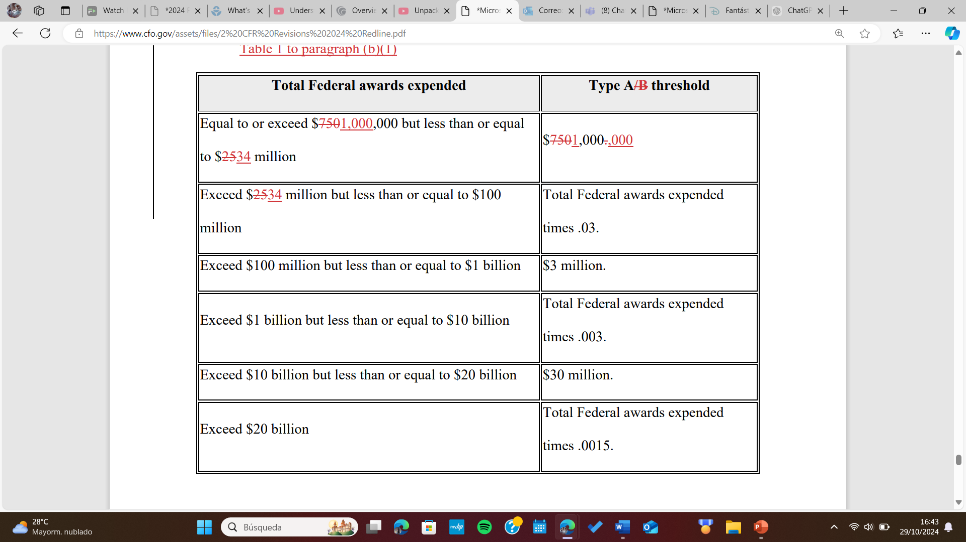
Major Program Determination. Section 200.518
Increased the Type A threshold to $1,000,000 while also increasing the amount of awards expended for which it applies (from $25 million up to $34 million).

Slide 58
THANK YOU

